Slide 1
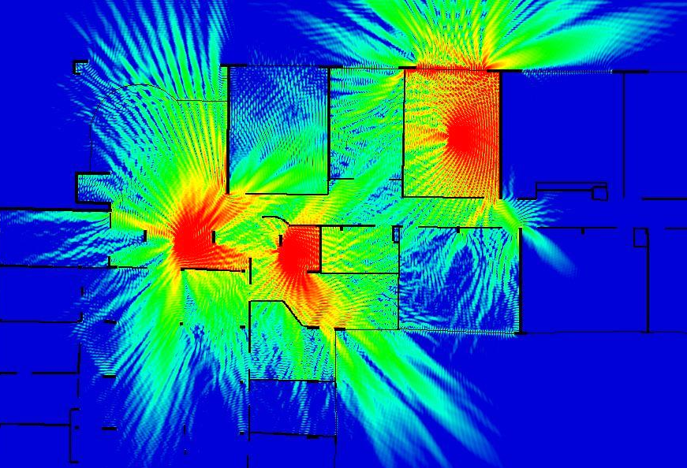
4th year – Electrical Engineering Department
Antennas
Basics and Principles of Wireless Communications
Guillaume VILLEMAUD

Slide 2
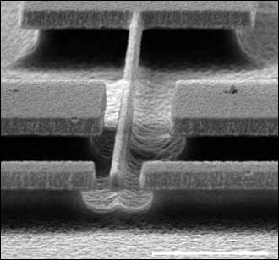
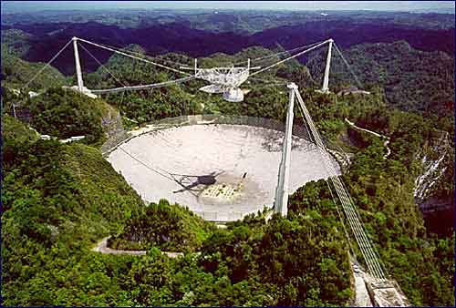
What are we talking about ?
Let’s talk about an antenna (or aerials), an electrical device which converts a guided electric power into free space electromagnetic waves, and vice versa.
There are a multitude of types of antennas, with very various sizes and forms, with more or less complex modes of operation. We will define the features and properties common to these different devices, as well as their areas of application.

Slide 3
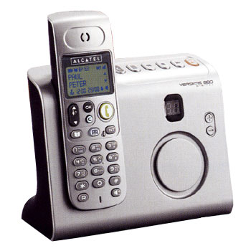
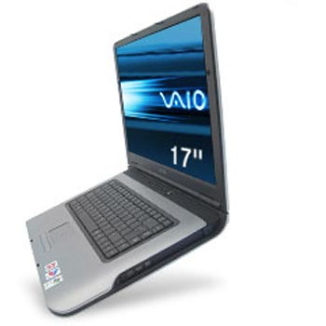
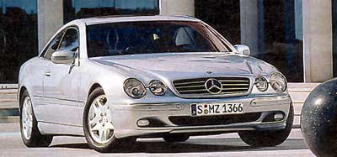
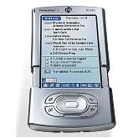
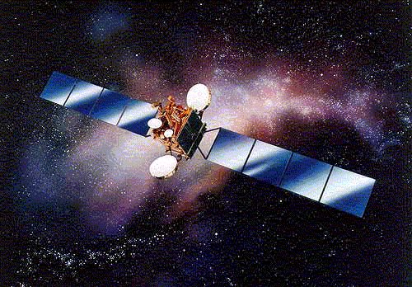
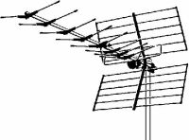
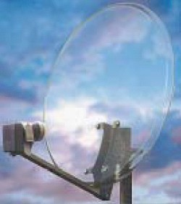
Antennas in everyday life
GSM 900 MHz
DCS 1800 MHz
UMTS 2 GHz
LTE 800 MHz, 2.6 GHz
Analog 800 MHz
DECT ~1900 MHz
Collision avoidance Radar ~80 GHz
Remote Toll ~6 GHz
Lock Remote control 433 MHz
Wifi / Bluetooth / UWB
2.4 à 6 GHz
TV terrestrial 500 MHz
Satellite systems 1 to 45 GHz (Ex : Television 12 GHz, GPS 1.5 GHz)

Slide 4
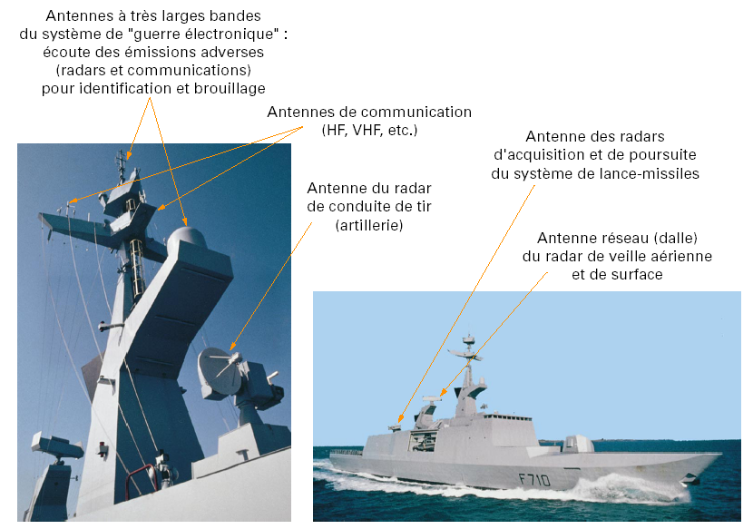
Military boat
Wideband antennas for « Electronic war »: listening to foe’s transmissions (radars and comms) for identification and jamming
Communication antennas (HF, VHF, etc.)
Radar antennas for missile-launching system
Radar antenna for fire control
Array antenna for aerial and surface surveillance radar

Slide 5
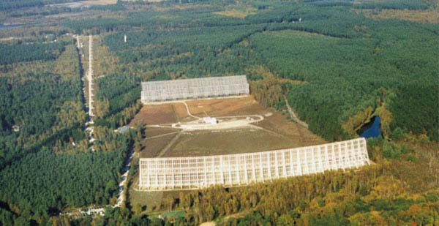
Radiotelescope 1 to 3,5 GHz
Plane mobile mirror with an East-West axis(height 40 m ; length 200 m ; surface accuracy 4 mm; weight 700 t)
Antenna focal point, receiving horns and preamplifiers cooled at – 250 °C mobile over an arc of 250 m
Nançay Center (Cher, France)
Fixed spherical mirror, North-South axis (height of 35 m, length 300 m, surface accuracy 3 mm; radius 560 m)

Slide 6
Main issue: energy
3 MHz
100m
30 MHz
10m
300 MHz
1m
3 GHz
10 cm
30 GHz
1 cm
300 GHz
1 mm
120 dBm
Radars (Weather)
1GW
100
Radars (military)
Satellites
80
1MW
TV UHF
60
Oven
TV VHF
1KW
40
TFTS
Electronic Toll
Amateurs
GSM
1W
20
Amateurs
DECT
0
1mW

Slide 7
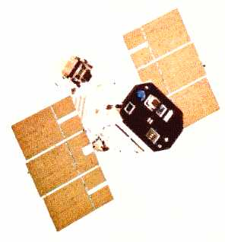
Ex : Earth-Satellite Communication
Terrestrial Antenna
1GW
Isotropic Power
Satellite Antenna
1MW
1kW
1W
Terrestrial Amplifier
Low Noise Amplifier
Output Signal
Ampli
1mW
1µW
Input Signal
Antenna Gain
1pW
Received Signal
AntennaGain
1fW
Received Signal on earth

Slide 8
Radio transmission chain
Emitter part:
Usefull signal
Cod
Mod
duplexeur
ampli
Circulator
antenna
BB
Synth.
fo
Receiver part:
Usefull signal
antenna
duplex
ampli
Demod
ampli
Decod
LNA
Synth.
fi

Slide 9
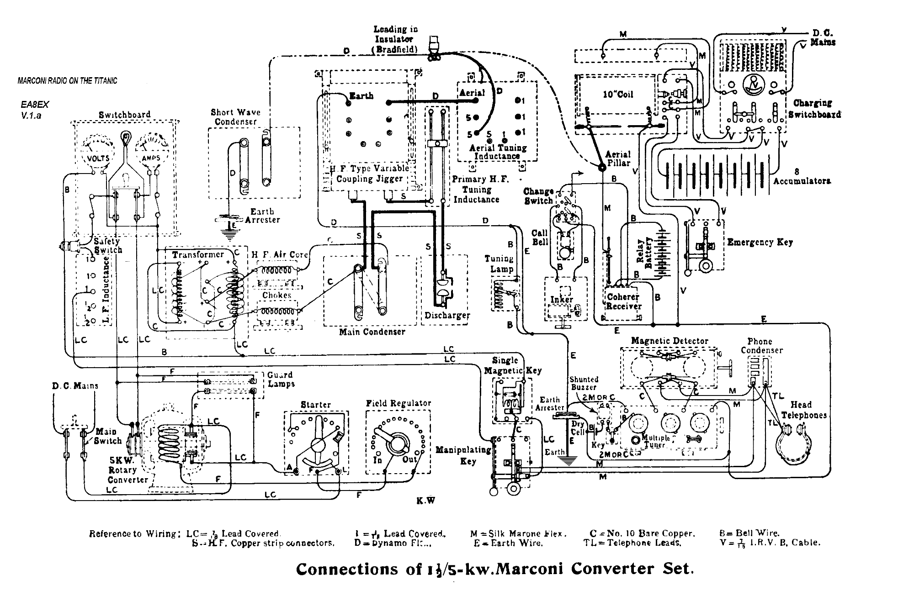
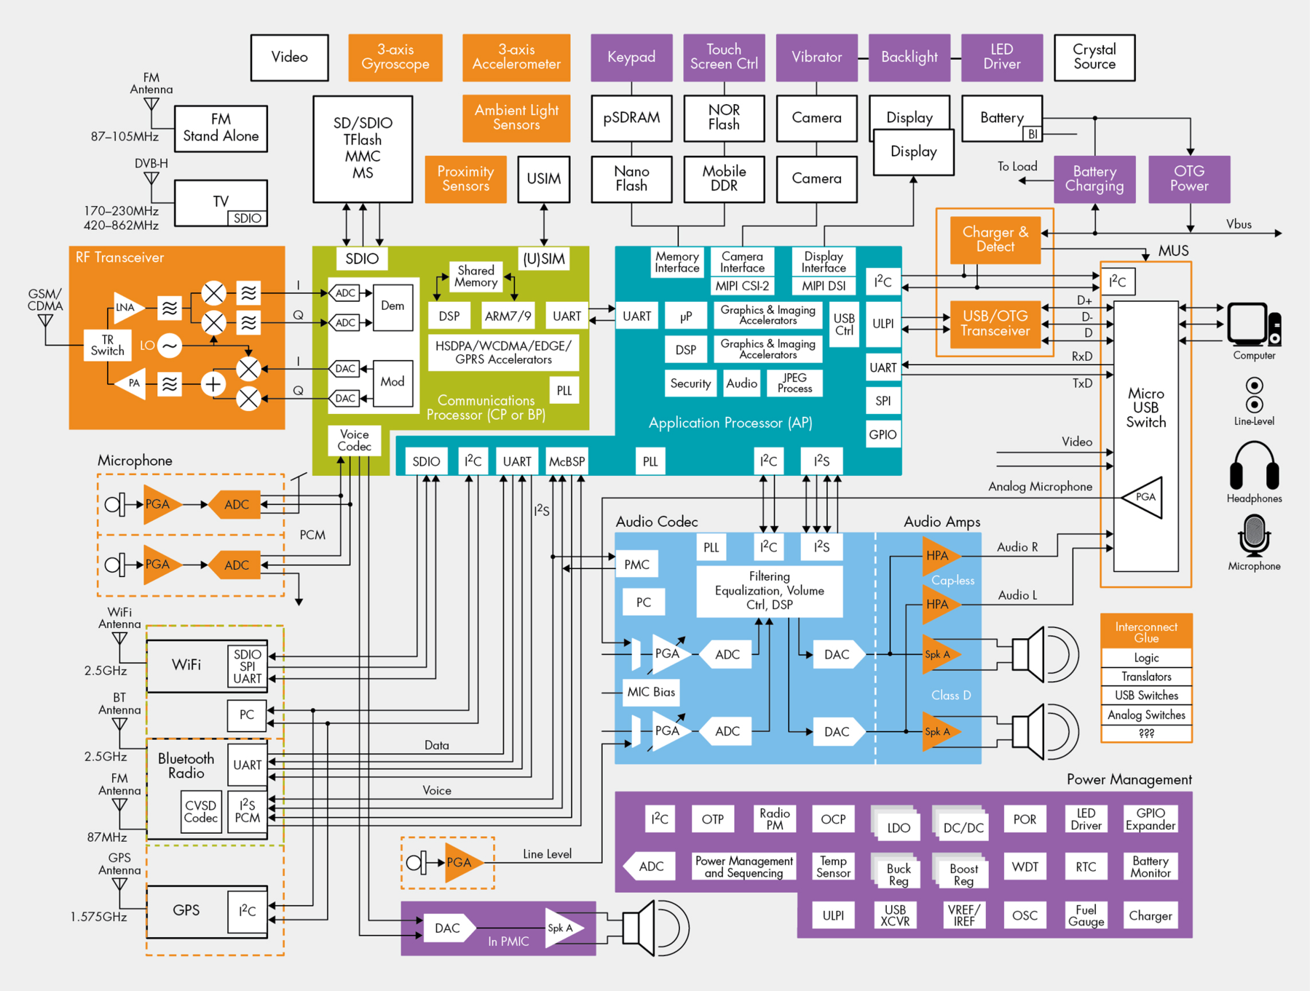
Cellphone example

Slide 10
Concept of Radio channel
Global radio transmission chain:
RF emitter
RF receiver
dig/analog
analog/dig
Guided Propagation
Free space Propagation
Guided Propagation
Radio channel
"Boxes" containing the electronics are connected to the antennas via lines or cables (feeders). From a signal processing perspective, the set of deformations of the wave generated by the wireless + wired transmission form the radio channel.

Slide 11
Where do we loose energy?
attenuation, dispersion
attenuation, dispersion
Propagation environment
Component noises
Component noises
Impedance mismatch
Impedance mismatch
Reflections, diffractions, multipaths, obstacles, diffusion, fading, pathloss, weather...
And all these parameters are varying in time, frequency, space and wave polarization…

Slide 12
Main topics
To properly understand all phenomenon driving antennas behavior, as well as their integration in a complete system, pre-requisites are:
basics of electromagnetism (Maxwell’s equations, EM wave propagation…);
basic knowledge of transmission lines theory and particularly impedance matching principles (progressive or stationary waves..);
take a step back: antennas represent a practical and “visual” application of Maxwell’s theory, building the bridge between purely theoretical equations and real physical phenomenon.

