Slide 1
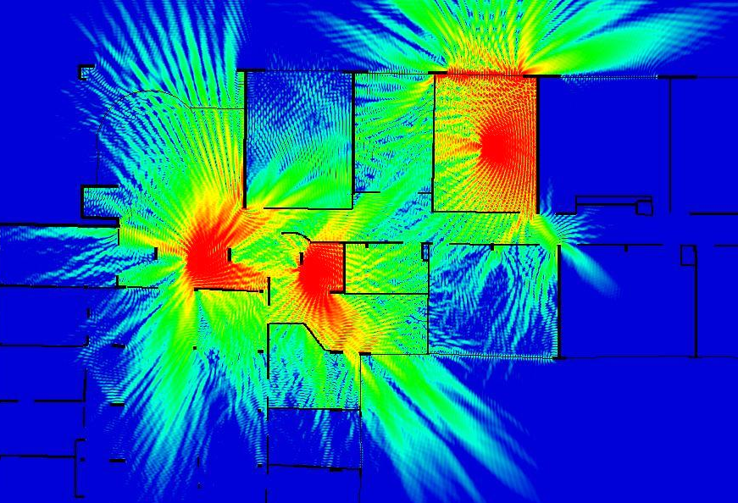
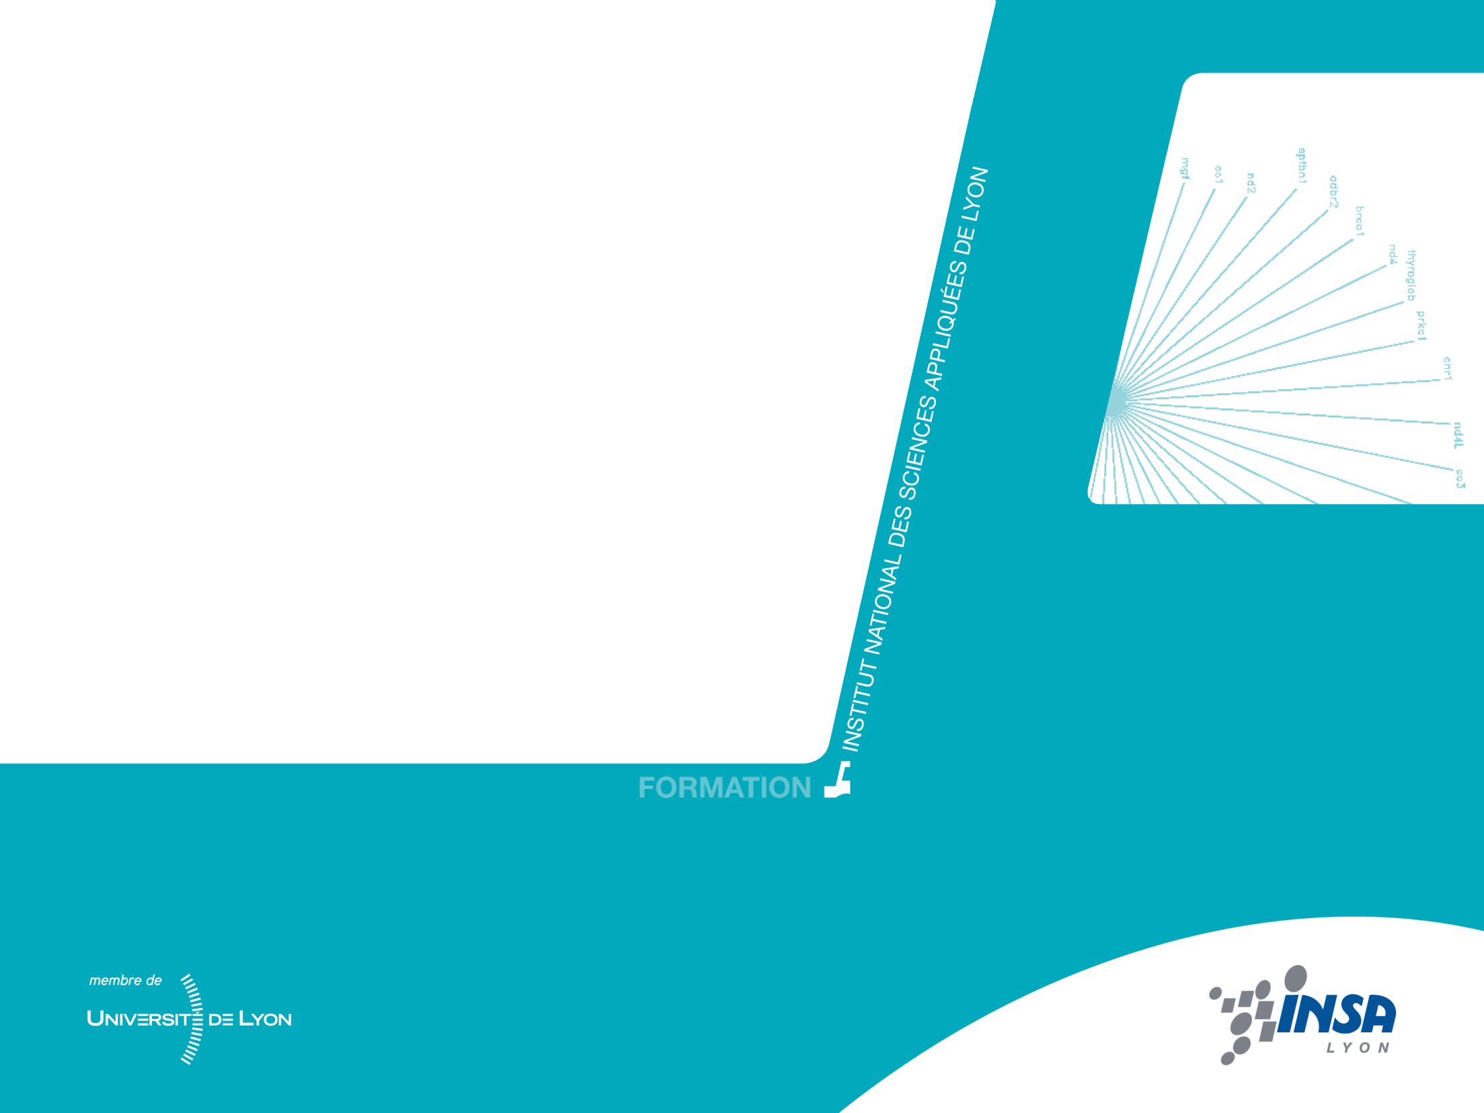


4th year – Electrical Engineering Department
Main Principles of Radiation
Guillaume VILLEMAUD

Slide 2
First considerations
Two important points:
Most of antennas are metallic
Huge majority of antennas are based on resonators
In a metal, by default the free electrons move erratically. When creating a difference of potential (eg sinusoidal), the internal field then controls the distribution of charges.
Currents and charges are then created as basic sources of electromagnetic field.
But according to their distribution and relative phases, the overall field delivered by a metallic element is the sum of all contributions of these basic sources.

Slide 3
Radiation mechanism
Charges transmitted over a straight metal at a constant speed do not produce radiation.
+++
No radiation
If the charges encountered a discontinuity (OC, bend ...) their speed changes, then there is radiation.
+++
Radiation
In a resonant structure, charges continuously oscillate, creating a continuous stream of radiation.
High radiation
+++

Slide 4
Loaded two-wire line
Reminder on transmission lines:
Zr
x
superposition of an incident and a reflected wave
Two-wire line closed on a load
Without loss

Slide 5
Open-ended two-wire line
Open-ended line:
O.C.
y
Line with an open-circuit
Stationary waves

Slide 6
Resonant line
C.O.
Line with an open-circuit
Stationary waves
In practice, when the wires are relatively close, the currents are out of phase, the total radiated field is close to zero (thank goodness).

Slide 7
Bended wires
The classical approximation considers that if the arms of the line are moved away, the current distribution remains the same.

Slide 8
Radiating dipole
Then we have inphase currents for effective radiation: the principle of the dipole antenna
Problem: in practice, there is mismatch. Then we seek a resonant antenna having an input impedance matched to a progressive wave line.

Slide 9
Reminder on EM fields
Medium characteristics:
To study phenomena of electromagnetic wave propagation, a medium will be defined by:
Its complex electrical permittivity
(F/m)
Its complex electrical permeability
Its conductivity
(S/m) electrical loss

Slide 10
Radiation sources
Currents and charges present in this medium are called primary sources:
Surface current density
Volume charge density
(A/m²)
(Cb/m³)
These sources create:
Electric and magnetic fields
(V/m)
(A/m)
Other currents and charges
and
Induction phenomena

Slide 11
Maxwell’s Equations
In an isotropic and homogeneous medium, we obtain these equations :
Sources can be distributed as linear, surfacic or volumic densities.

Slide 12
Resolution domain
Two distinct areas solving these equations are considered: in the presence of charges and currents or out of any charge or current.
The resolution in the presence of charges and currents is used to determine the field distribution produced by a linear, surface or volume charges and currents (which leads to the radiation pattern of the antenna).
The second type of resolution is required to calculate the electromagnetic waves propagated in free space (or in a particular medium).

Slide 13
Sinusoidal source
Still in the case of homogeneous and isotropic media, with harmonic source the following equations are obtained:
Then we can solve these equations to determine the field produced by the charges and currents present on a conductor.

Slide 14
Relation to the surface
Interface with a perfect conductor
ε₁, μ₁, σ₁
The electric field is always perpendicular to the conductor.
The magnetic field is always tangent to the conductor.
The electric field is proportional to the charges on the surface.
The magnetic field is proportional to the surface current.

Slide 15
EM potentials
To assess the effects of an isotropic source at a point P of space we can introduce the vector and scalar potentials:
Knowing that
we can write
z
P
θ
Vector A is defined in a gradient approximate, then there is a function V satisfying:
r
o
y
ϕ
x

Slide 16
EM potentials
Expressing Maxwell's equations based on the potential, we obtain the wave equations:
The resolution (based on the complex Green's functions) provides for a linear distribution:
Scalar potential
Vector potential

Slide 17
Elementary source
The Hertzian electric dipole is a linear element, infinitesimally thin, of length dl (<<λ) where we can consider a uniform distribution of currents (infinite speed).
z
P
θ
r₀
+q
r
r₁
i(t)
x
-q
This is a theoretical tool to predict the behavior of any antenna as the sum of elementary sources.

Slide 18
Radiated field calculation
The problem is rotationally symmetrical relative to Oz. The vector potential has only one component Az:
Then we obtain:
The magnetic field has just one component:

Slide 19
Electric field calculation
Then we can deduce the electric field which is produced :
Electric field with two components: and
So we end up finally with three components of the radiated field.
Depending on the distance from the observation point P with respect to the source, we will do different approximations to simplify expressions.

Slide 20
Approximations depending on r
The terms in 1/r represent the radiated field (predominant when large r) 1/r² terms give the induced fields and terms in 1/r³ the electrostatic field.

Slide 21
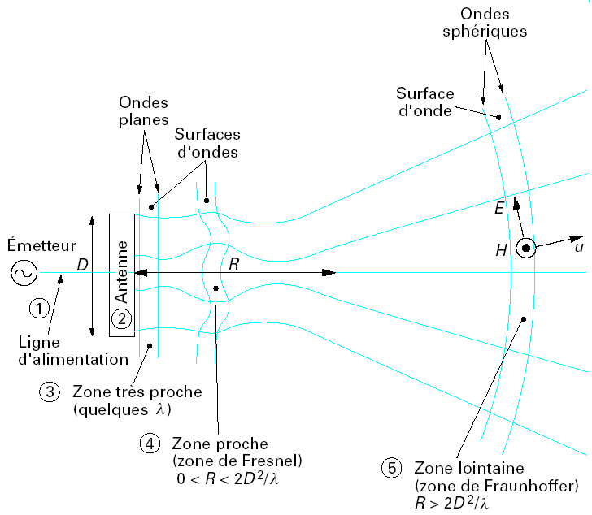
Zones of radiation
Spherical waves
Plane waves
Wave surfaces
Wave surfaces
Emitter
Antenna
Feeding line
Very near zone
(some wl)
Near field zone (Fresnel)
Far field zone (Fraunhoffer)

Slide 22
Zones of radiation
Quasi-constant
Fluctuating
Decreasing in 1/r²

Slide 23
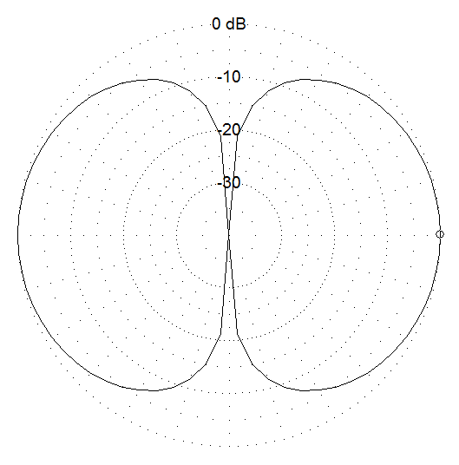
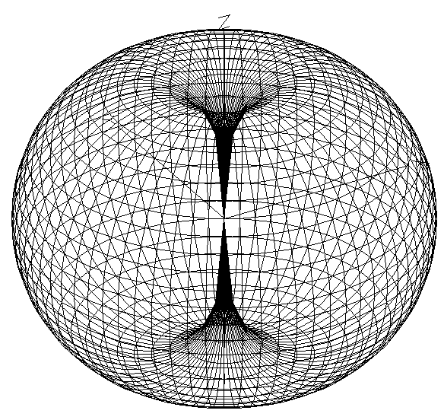
Hertzian dipole’s radiation
Far field approximation :
i(t)
Free space

Slide 24
Farfield Propagation
Returning to the harmonic equations in the case of homogeneous, isotropic media containing no primary sources, we obtain the following equations:
Remark : In this case, we see that the equations in E and H are almost symmetrical, the only difference being the absence of charges and magnetic currents. We can then introduce fictitious magnetic sources for these symmetrical equations. The solution of the electrical problem then gives the magnetic problem solution and vice versa.

Slide 25
Propagation equations
The propagation equations for the fields E and H (expressed in complex instantaneous values​​) are written as follows:
If propagation is in the direction Oz, it comes:
and
The ratio represents the propagation speed of the wave.
Knowing that generally we consider that (except for ionised or magnetic medium) we can write :

Slide 26
Solutions
In a sinusoidal steady state regime, these equations admit solutions of the form:
and
with : (wavenumber)
The ratio between absolute values of and represents the wave impedance of the considered medium (in ohms):
it’s a real value.
In the air: 377 ohms
We have a fundamental relation:

Slide 27
Spherical wave –Plane wave
A point source (Q charge) produce radiation of a spherical wave.
Indeed, solving the equations of potential in the case of a point source is symmetrical spherical revolution, and gives solution for:
In Farfield, this leads to:
The wave surface is a sphere centered at the point source

Slide 28
Plane wave approximation
Solutions of Maxwell's equations are numerous (depending on the initial conditions).
All can be expressed as the sum of plane waves.
Wave front
l
E
H
Propagation direction

Slide 29
Carried power
x
E
z
y
When the far field condition is satisfied, the wavefront can be assimilated to a plane wavefront. The power carried by the wave is represented by the Poynting vector:

Slide 30
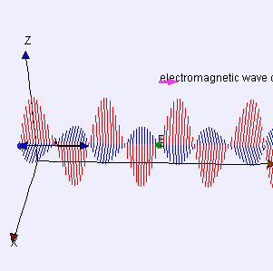
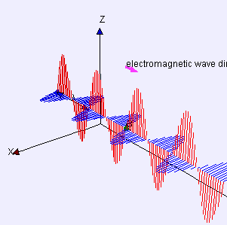
Plane wave propagation

Slide 31
Polarization of the wave
We know that far-field E and H are perpendicular to each other and perpendicular to the direction of propagation.
But depending on the type of source used, the orientation of these vectors in the plane wave can vary.
Based on the variations in the orientation of the field E over time, we define the polarization of the wave.
In spherical coordinates, the components of the E field of a plane wave is described by:
with
and

Slide 32
Linear polarization
First hypothesis: components pulse in phase
Several possibilities: horizontal, vertical or slant polarization
animation

Slide 33
Example with hertzian dipole
Linear vertical polarization
i(t)

Slide 34
Linear horizontal polarization
i(t)

Slide 35
Example with 2 inphase dipoles
Slant linear polarization
i(t)

Slide 36
Circular polarization
Second hypothesis: components vibrate in phase quadrature and magnitudes are equal

Slide 37
Circular polarization
i(t)

Slide 38
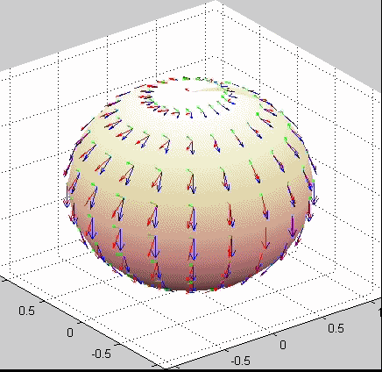
Animations

Slide 39
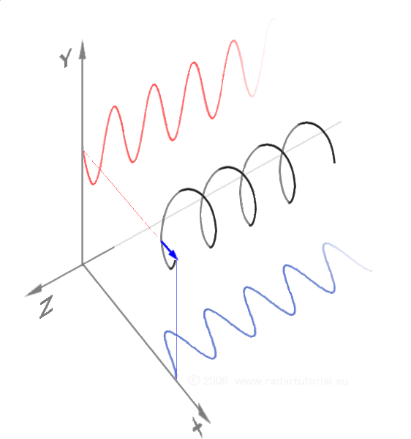
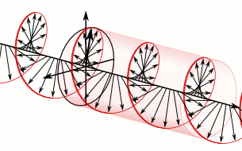
Illustration of Circular polarization

Slide 40
Elliptic Polarization
3 modes of polarization
  Linear polarization
    vertical, horizontal, slant (plane H or E)
  Circular polarization
    Left-hand or right-hand
  Elliptic polarization
    General definition

Slide 41
Fundamental theorems
To study the functioning of antennas, four fundamental theorems are known:
the Lorentz reciprocity theorem
the theorem of Huygens-Fresnel
the image theory
Babinet's principle

Slide 42
Lorentz reciprocity
If we consider that two distributions of currents I₁ and I₂ are the source of E₁ and E₂ fields, Maxwell's equations allow to write:
radiating systems are reciprocal (note only in passive antennas).
Pf
Pr
Pr
Pf

Slide 43
Huyghens-Fresnel’s principle
Principle for calculating the radiation at infinity of any type of source
Arbitrary surface
sources
equivalent surface sources (electric and magnetic)
No field

Slide 44
Application to radar
Principle for bistatic radar
Plane wave
target
P
Observation point
The field received in P is the sum of the field that would be received without the obstacle (known) and diffracted by the obstacle. It is then possible to calculate the inverse of the surface formed by sources providing such a field.

Slide 45
Image theory
At an observation point P, the field created by a source + q placed above a perfect ground plane of infinite dimensions is equivalent to the field created by the combination of this charge with its image by symmetry with a charge -q.
P
P
x
x
+q
+q
-q

Slide 46
Image of currents
The same principle applies to the current sources.
The image is formed by the symmetry of the current distribution of opposite sign (phase opposition).
P
P
x
x
I
I
I
This is the basis for many applications in antennas

Slide 47
Babinet’s principle
Babinet's theorem shows the symmetrical appearance of Maxwell's equations.
H
E
case 1
case 2
The total field of case 1 will be equal to the diffracted field in case 2 and vice versa.

Slide 48
Application to antennas
Any slot in a ground plane of large dimension will have the same behavior that the equivalent metallic antenna in free space except that the E and H fields are reversed.
E
H

