Slide 1
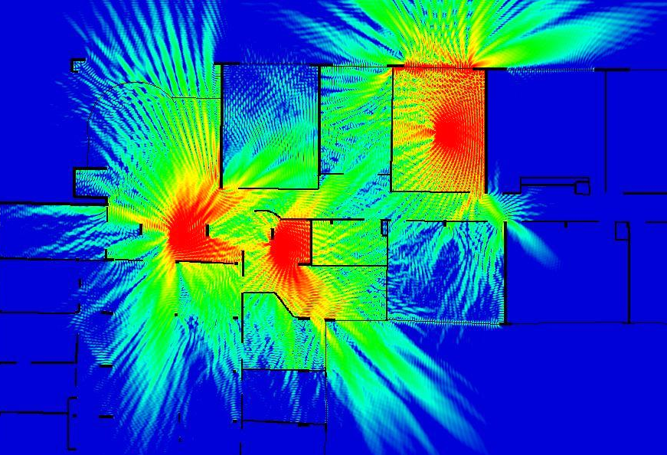



4th year – Electrical Engineering Department
General characteristics of antennas
Guillaume VILLEMAUD

Slide 2
Key Points
We have seen that the antenna theory is based on the radiation produced by the sources (charges, currents) on the surface of a conductor.
When we want to describe the operation of a particular antenna, some basic features common to all types of antennas are given:
  Input impedance
  Radiation pattern
  Gain
  Polarization

Slide 3
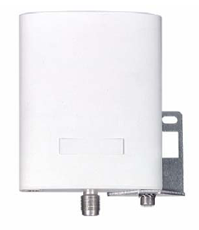
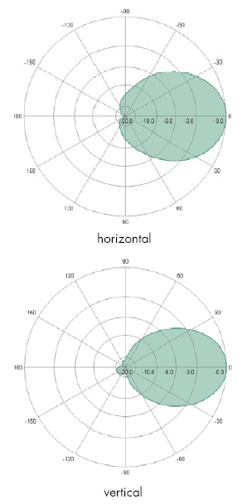
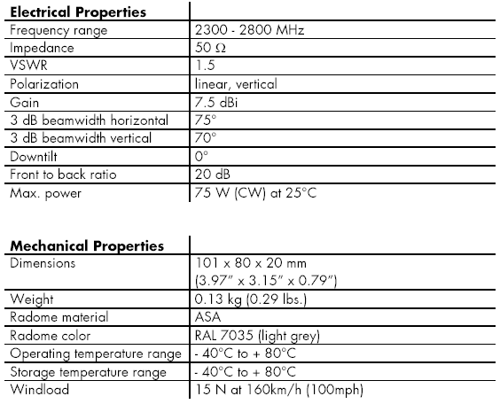
Example of Datasheet
Access Point Antenna for WiFi systems

Slide 4
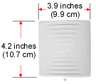
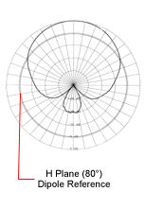
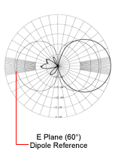
Example of Datasheet (2)
Access Point Antenna for WiFi systems

Slide 5
Input impedance
If we take the example of the open line, the distance between the arms causes a change in impedance.
The wave is then reflected at the interface between the line and the antenna, with significant energy loss.
The goal is then to return to a matched system.
mismatch
Zi
Zc
Zr=Zc
ei

Slide 6
The antenna as a circuit
Pa
Pi
Pe emitted power
generator
Pr
Ze
The antenna is a resonant (stationary wave) system, it must ensure that the impedance presented to the front line (its input impedance) is adapted to it.
The line is in progressive wave, the power is fully transmitted to the antenna.
The antenna is then used as an impedance transformer between the transmission line and free space.
The radiated power depends on the accepted power and antenna losses.

Slide 7
Reflection Coefficient
The quality of matching of an antenna is given by its characteristic impedance (usually 50 ohms), or by giving the reflection level.
Reflection coefficient on power:
is the reflection coefficient on voltage
Input impedance deduced from reflection values:

Slide 8
Expression in decibels
Most of the time the values are ​​expressed in decibels:
return loss
But we can also found the use of VSWR (Voltage Standing Wave Ratio):
Often expressed with the form: n:1

Slide 9
Conversions
VSWR Return Loss (dB) Reflected Power (%) Transmiss. Loss (dB) VSWR Return Loss (dB) Reflected Power (%) Transmiss. Loss (dB)
1.00 ∞ 0.000 0.000 1.38 15.9 2.55 0.112
1.01 46.1 0.005 0.0002 1.39 15.7 2.67 0.118
1.02 40.1 0.010 0.0005 1.40 15.55 2.78 0.122
1.03 36.6 0.022 0.0011 1.41 15.38 2.90 0.126
1.04 34.1 0.040 0.0018 1.42 15.2 3.03 0.132
1.05 32.3 0.060 0.0028 1.43 15.03 3.14 0.137
1.06 30.7 0.082 0.0039 1.44 14.88 3.28 0.142
1.07 29.4 0.116 0.0051 1.45 14.7 3.38 0.147
1.08 28.3 0.144 0.0066 1.46 14.6 3.50 0.152
1.09 27.3 0.184 0.0083 1.47 14.45 3.62 0.157
1.10 26.4 0.228 0.0100 1.48 14.3 3.74 0.164
1.11 25.6 0.276 0.0118 1.49 14.16 3.87 0.172
1.12 24.9 0.324 0.0139 1.50 14.0 4.00 0.18
1.13 24.3 0.375 0.0160 1.55 13.3 4.8 0.21
1.14 23.7 0.426 0.0185 1.60 12.6 5.5 0.24
1.15 23.1 0.488 0.0205 1.65 12.2 6.2 0.27
1.16 22.6 0.550 0.0235 1.70 11.7 6.8 0.31

Slide 10
Radiation resistance
Radiation resistance and loss resistance
For purely metallic antennas, the loss resistance could be neglected.
For a purely resitive antenna (accorded antenna), X=0

Slide 11
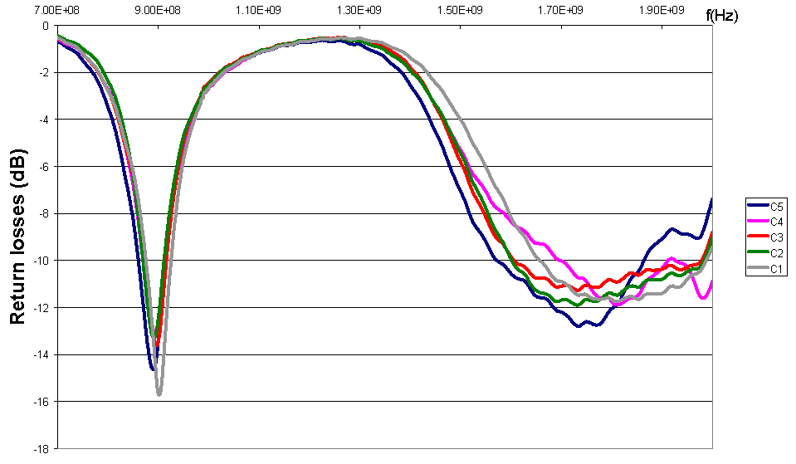
Bandwidth
There are many definitions of bandwidths. The most common is the bandwidth in impedance matching where the reflection coefficient of the antenna meets a certain level.

Slide 12
Relation to the impedance
The complex impedance of an antenna varies with frequency. It corresponds to variations in current distribution on the surface.
We try to match the operating frequency with a purely real impedance similar to that of system (usually 50 ohms).
Serial resonance
Parallel resonance

Slide 13
Serial or parallel resonances
The geometry of the antenna and its feeding mode affects the impedance. We usually try to place as close to resonance and cancel the imaginary part.
Antenna
Serial resonance
Parallel resonance
Max of current at the generator
Low impedance
Min of current at the generator
High impedance

Slide 14
Examples of matching points
Z ,
Ω
Example of the dipole
60
Matching zone
case n°1
40
20
R
e(Z)
0
i
-20
I
m(Z)
-40
0,2
0,4
0,6
0,8
1
1,2
1,4
1,6
1,8
f
Ω
fr
120
Z ,
100
case n°2
v
80
60
I
m(Z)
40
20
R
e(Z)
0
-20
0,2
0,4
0,6
0,8
1
1,2
1,4
1,6
1,8
f
Ω
fr
Z ,
450
case n°3
350
250
R
The choice of the feeding point can determine the bandwidth;
150
e(Z)
I
m(Z)
50
-50
-150
0,2
0,4
0,6
0,8
1
1,2
1,4
1,6
1,8
f
fr

Slide 15
Mutual Coupling
Two closely spaced antennas influence each other by a coupling of electromagnetic fields.
This coupling must be taken into account because it changes the antenna characteristics (impedance and radiation).
Rapid limitation of analytical models
Electromagnetic modeling

Slide 16
Radiation characteristics
To account for the performance of the antenna from the point of view of the radiated fields are used:
        The characteristic function (field pattern)
        The radiation pattern
        The directivity
        The gain
        The beamwidth
        The effective area
  And therefore to build the link between two antennas we will use the link budget (Friis’ formula)

Slide 17
Characteristic function
The characteristic function is used to represent changes in the level of the radiated field in the far field zone as a function of the direction considered.
Case of the Hertzian dipole:
I : max. intensity
Characteristic function of the hertzian dipole

Slide 18
Radiation Pattern
Global definition:
z
y
Hertzian dipole
x
x
Vertical plane
Horizontal plane

Slide 19
Power Notion
The total radiated power is equal to the flow of the Poynting vector through a closed surface surrounding the antenna.
In farfield, it comes:
Surface power density
To represent this a normalized power is often used:

Slide 20
Solid Angle
The power flow density can also be expressed in steric density according to the solid angle
dΩ
Steric power density or radiation intensity

Slide 21
Radiation resistance
When we link between the radiated power and the power dissipated by a load, we can determine the radiation resistance from the characteristic function.

Slide 22
Antenna Directivity
Pe is the total radiated power, it is said that the antenna is isotropic when the steric density in any given direction is expressed as:
We call directivity the relationship between power density created in a given direction and the power density of an isotropic antenna.

Slide 23
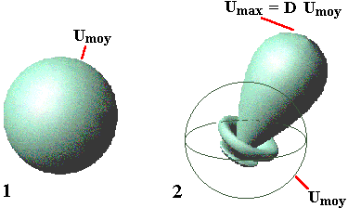
Meaning of the directivity
For isotropic antenna, D=1 whatever the direction

Slide 24
Antenna Gain
The gain is defined in the same way as the directivity, but taking into account of the power supplied to the antenna:
This gain is sometimes called actual or realized gain as opposed to intrinsic gain not taking into account all the losses of the antenna (without loss of mismatching).
If there is no loss, the gain is equal to the directivity

Slide 25
Relation to the resistance
Starting from:
We can give a simple formula to calculate the gain function form the radiation resistance :
Still in the no matching loss hypothesis

Slide 26
Radiation pattern teminology
Axis of the main lobe
Half-power beamwidth(-3dB)
Zero of radiation
Secondary lobes
(sidelobes)
1
0,8
0,6
0,4

Slide 27
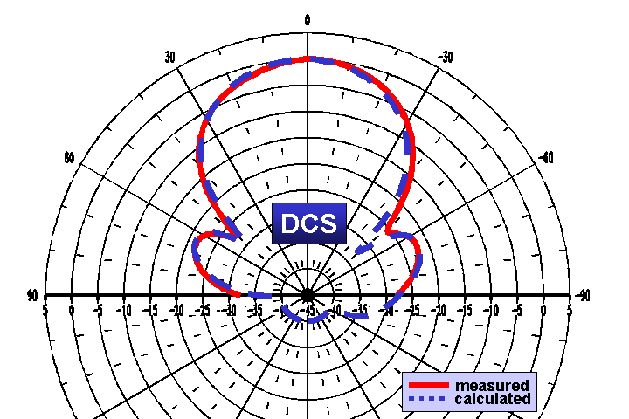
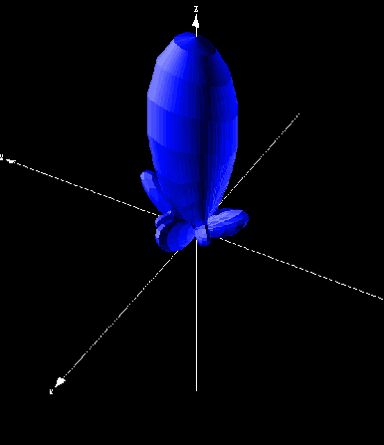
Types of representation
There are a multitude of ways to represent the radiation of an antenna: field pattern, power pattern, gain, directivity, polar or Cartesian, linear or decibels, 2D or 3D

Slide 28
Example of microwave bridge
Radiation pattern
Linear radiation pattern (P/Pmax)
20
1
0
0.8
(dBi)
-20
0.6
P
θ
G
θ
-40
0.4
-60
0.2
-80
0
-200
-100
0
100
200
-200
-100
0
100
200
angle (°)
angle (°)
90
90
120
60
120
60
150
30
150
30
180
0
180
0
210
330
210
330
240
300
240
300
270
270

Slide 29
Reference planes
Excited mode:
H plane
E plane
Radiating element
Surface currents linked to the cross-polarization: Jx
Surface currents linked to the main polarization: Jy

Slide 30
Measurement methods
Impedance matching measurements
Vector Network ananlyzer
Antenna under test
Horn
T
RF out
A
motion
motion
motion
Motion control
Directional coupler
VNA
Radiation measurements
Computer

Slide 31
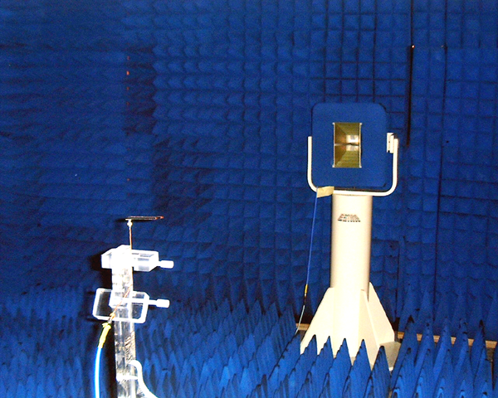
Measurement chambers

Slide 32
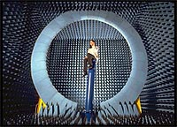
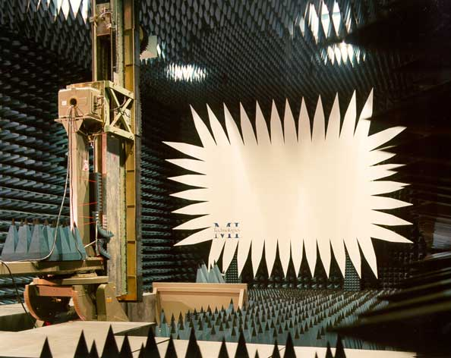
Measurement chambers

Slide 33
EIRP
When an antenna produces a radiated power Pe, the power density created in a given direction is the product of the gain in this direction by the power.
The Equivalent Isotropic Radiated Power is:
EIRP=Pe.Ge
This value is particularly usefull for standard’s definition.

Slide 34
Effective area
An antenna illuminated by a plane wave of power density ΔPs, we call effective area of the antenna quantity:
load
From the gain :

Slide 35
Effective area and gain
If we build a transmission between two antennas:
Pf
Pd
antenna 1
load
antenna 2
Reciprocity :
Then:
If we take the hertzian dipole as example, it comes:

Slide 36
Link Budget
Friis’ formula or link budget is used to calculate the power available at the receiver load depending on the power supplied to the emitting antenna.
We know
or

Slide 37
More detailed budget link
The previous formula assumes matched loads and the same antenna polarization. Otherwise, a more complete budget can be made:
It takes into account the impedance matching of antennas, their gains in the direction of communication and polarization efficiency.

Slide 38
Decibel expressions
An expression given in decibels is always relative, so a value relative to a multiplication or a division in the linear domain.
As we are expressing power values, we always use 10log (ratio).
This is still consistent with calculations with the field values in 20log.
To express absolute values like power level, we use a reference value, which could be 1 mW (dBm) or 1 W (dBW).
Directivities or gains are expressed in dBi (relative to isotropic) or dBd (relative to dipole).
Attenuation or amplification terms are expressed in pure dB.

