Slide 1
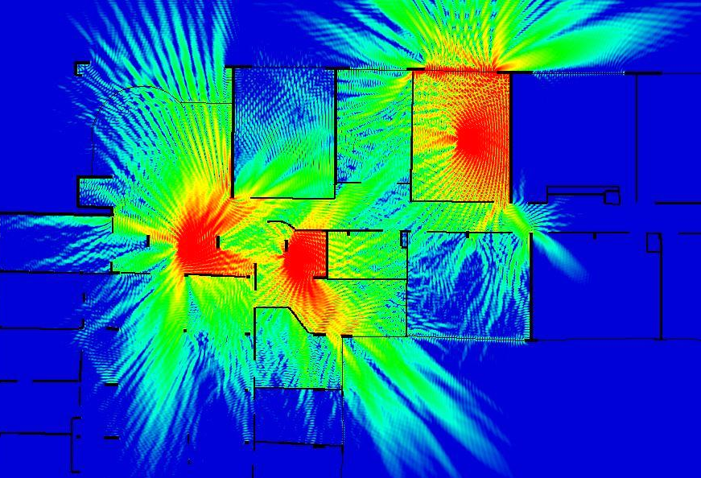
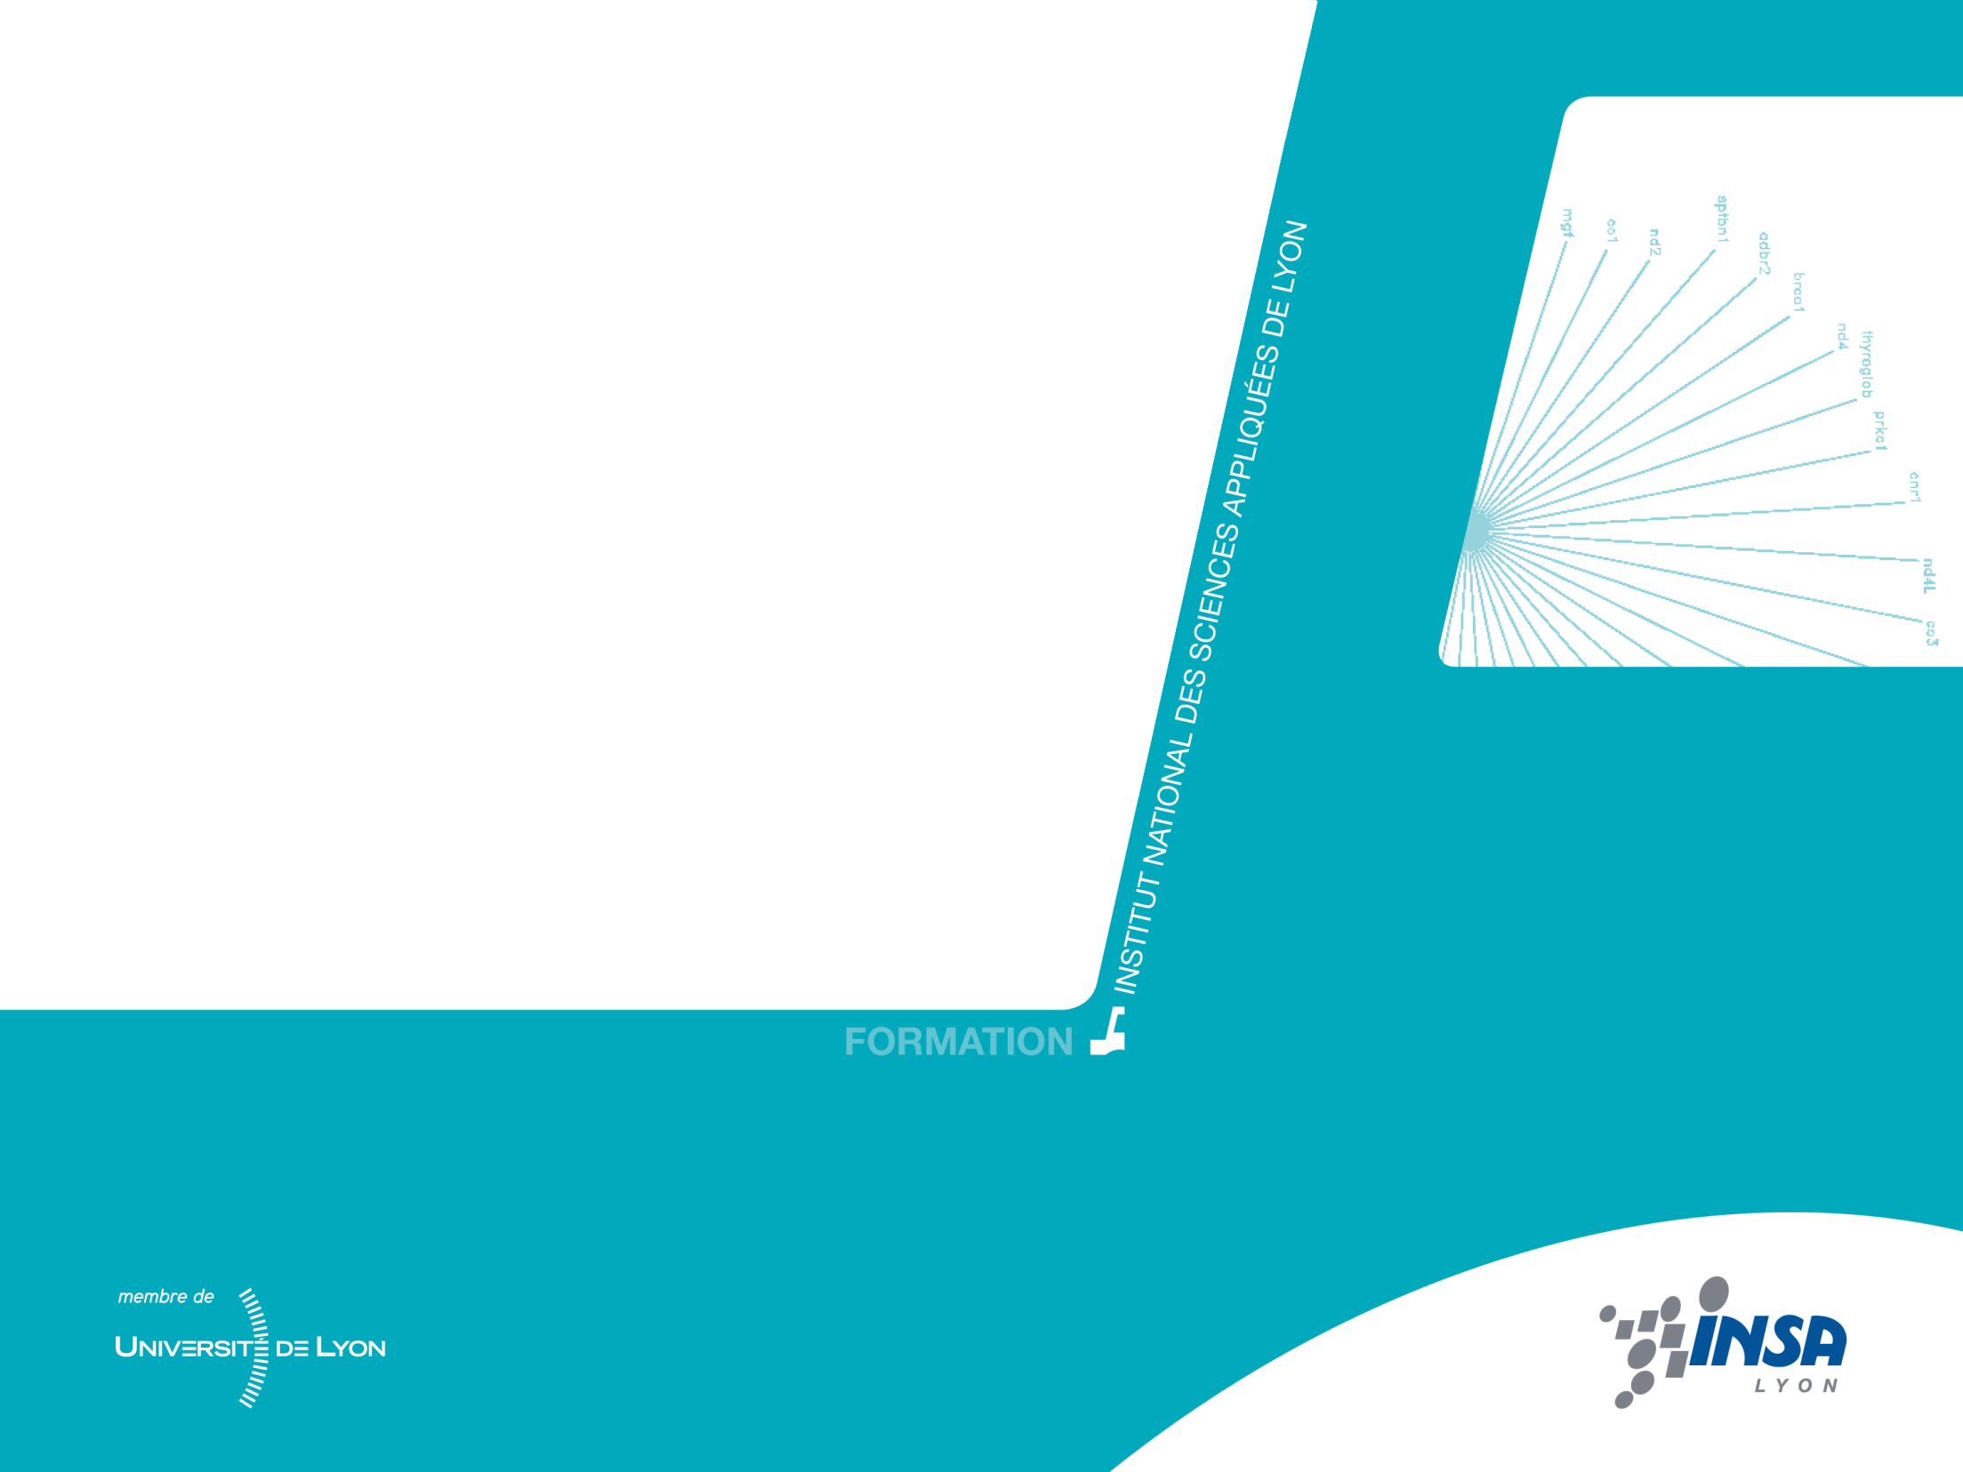


4th year – Electrical Engineering Department
Different kinds of antennas
Guillaume VILLEMAUD

Slide 2
Outline
We will see main families of antenna used to create a radiated radio wave:
  wire antennas (dipole, monopole Yagi)
  slot antennas (half or quarter wave)
  patch antennas (planar)
  aperture antennas (horn)
  reflector antennas (dishes)
We conclude this chapter by the principle of arrays of elementary antennas and beamforming techniques.

Slide 3
Wire antennas
By definition, the category of wire antennas includes all antennas formed of a conductor structure where, due to small diameter of cables, we consider only the linear current densities.
The basic antennas are: dipoles, monopoles, loops.
More advanced structures: helical, Yaguis, the log-periodic ...

Slide 4
RADIATING DIPOLE
The dipole antenna is a wire composed of two conductive strands apart in opposite directions. The source is most often presented in the center of the structure which gives a symmetrical system.
Current distribution:
l
We can calculate the radiated field
as the sum of contributions of elementary dipoles driven by an intensity I(z)

Slide 5
CHARACTERISTIC FUNCTION OF THE DIPOLE
To visualize the radiation:
with

Slide 6
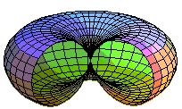
HALF-WAVELENGTH DIPOLE
The simpliest form of the radiating dipole is an antenna of total length λ/2, also known as half-wavelength dipole.
radiation
The maximum directivity obtained is 1,64 so 2,15 dBi or 0 dBd

Slide 7
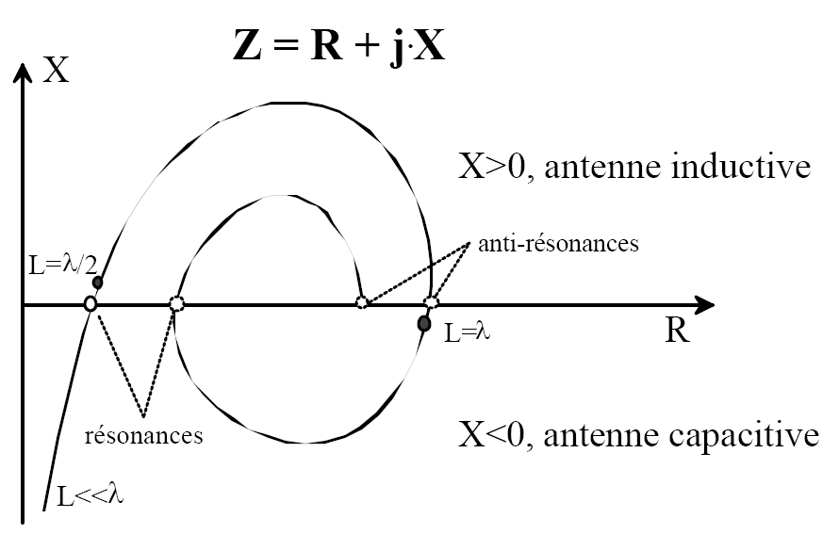
IMPEDANCE OF THE DIPOLE
Inductive antenna
Parallel resonances
Serial resonances
Capacitive antenna
Half-wavelength : Z=73+j42 ohms

Slide 8
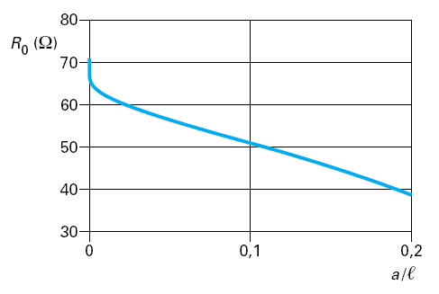
THICK DIPOLE
To match the dipole, we can adapt the diameter of wires (a) with respect to the length of the arms (l).

Slide 9
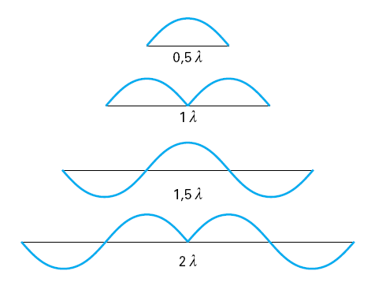
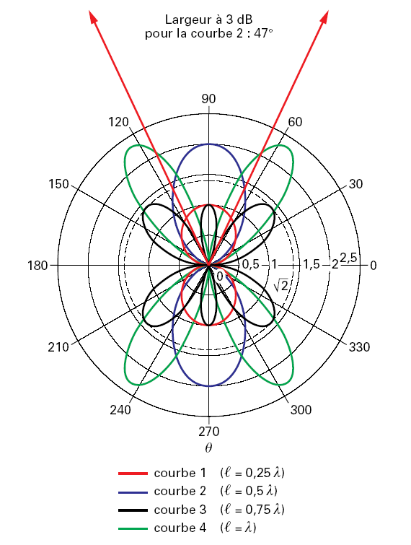
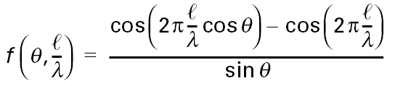
OTHER SIZE OF DIPOLES
General characteristic function:

Slide 10
OTHER SIZE OF DIPOLES

Slide 11
OTHER SIZE OF DIPOLES
λ/2

Slide 12
OTHER SIZE OF DIPOLES
λ

Slide 13
OTHER SIZE OF DIPOLES
3λ/2

Slide 14
OTHER SIZE OF DIPOLES
2λ

Slide 15
MONOPOLE ANTENNA
Image principle

Slide 16
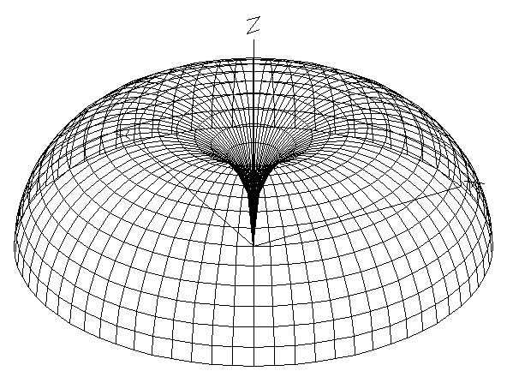
CHARACTERISTICS OF THE MONOPOLE
Half-space radiation
Gain increased by 3 dB
Quarter-wavelength: Z=36,5+j21 ohms

Slide 17
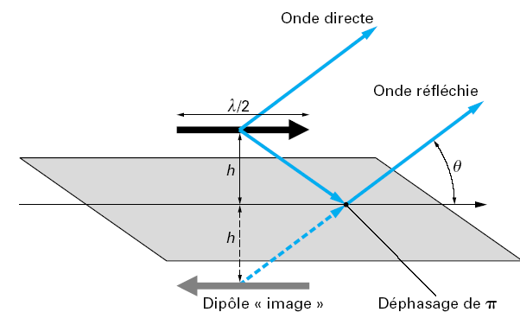
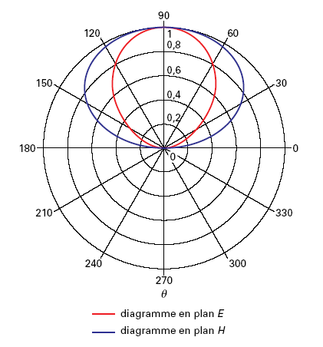
DIPOLE ABOVE A PERFECT REFLECTOR
Direct wave
Reflected wave
Image dipole
Phase difference of π

Slide 18
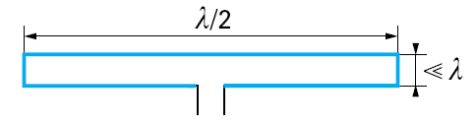
FOLDED DIPOLE
Same radiation characteristics
Impedance 300 ohms
Higher bandwidth

Slide 19
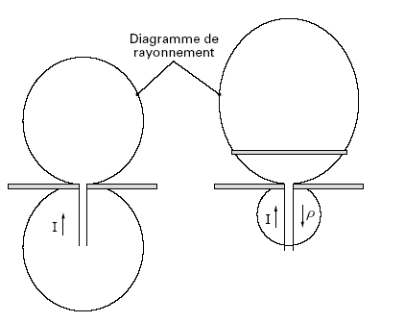
EFFECT OF PARASITIC ELEMENTS
If we place a passive element close to the feeded dipole, a coupling effect is established. By choosing slightly different sizes of these parasites, you can create behaviors like reflector or director.
Radiation patterns
Dipole alone
Dipole with parasitic element

Slide 20
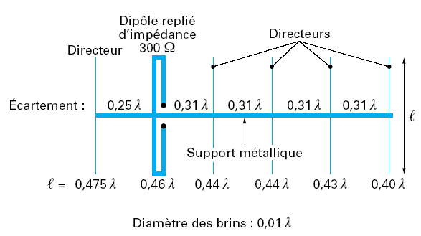
YAGI-UDA ANTENNA
Combining the effect of reflectors and directors elements, a highly directional antenna is obtained: the Yagi.
Folded dipole
Directors
Reflector
Spacing:
Metallic support
Wires diameter:

Slide 21
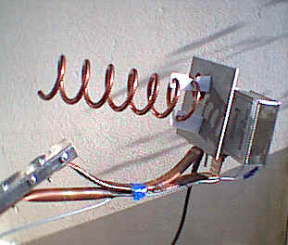
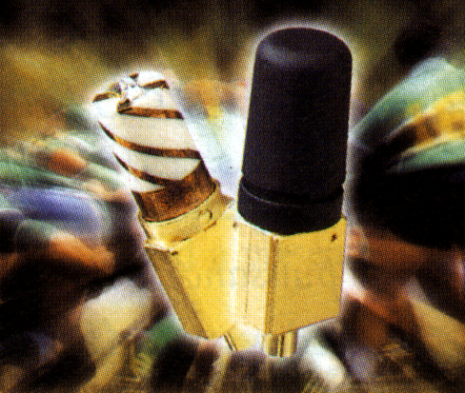
OTHER WIRE ANTENNAS
Resonating loop antenna
Helical antenna
Simple Helix
Radial mode
Axial mode
Multiple Helix

Slide 22
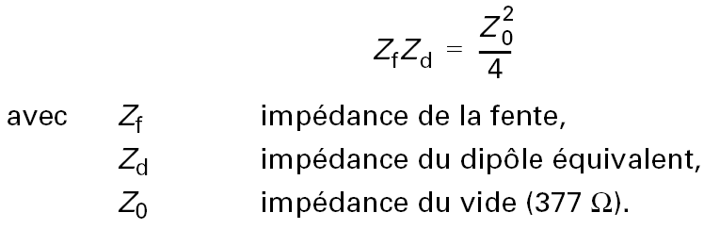
SLOT ANTENNAS
Illustration of Babinet’s principle
Dual of the dipole
λ/2 λ/4
Same behavior than the dipole antenna but changing the laws for E and H (therefore V and I).
By the way, inversion of impedance varaitions.
with
Impedance of the slot
Impedance of the equivalent dipole
Impedance of vacuum (377 ohms)

Slide 23
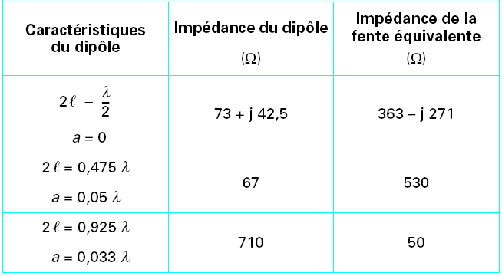
COMPARISON DIPOLE-SLOT
Dimensions
Impedance of the slot
Impedance of the dipole

Slide 24
PLANAR ANTENNAS
Patch Antenna
Metallization on the surface of a dielectric substrate, the lower face is entirely metallized. Directive radiation
Fundamental mode λ/2
substrate
Ground plane

Slide 25
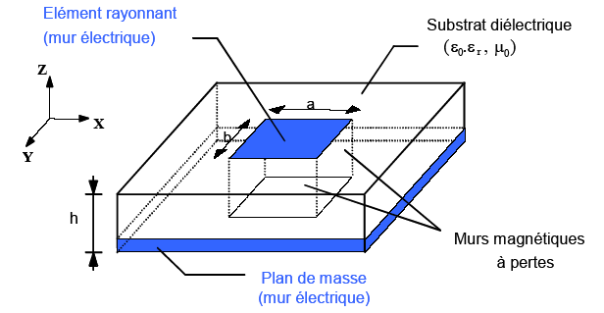


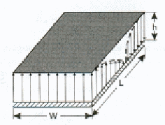
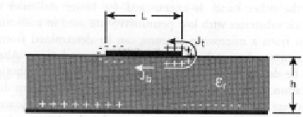
PATCH ANTENNAS
Principle of operation:
Leaky-cavity
Radiating element (electric wall)
Dielectric substrate
Lossy magnetic walls
Ground plane (electric wall)
Direction of main radiation

Slide 26
PATCH ANTENNAS
Feeding systems:
Feeding probe
Radiation pattern
Metallic plate
Radiating element
Dielectric substrate
Classical system: coaxial probe
Placement in order to match the desired mode
Coaxial probe
Ground plane

Slide 27
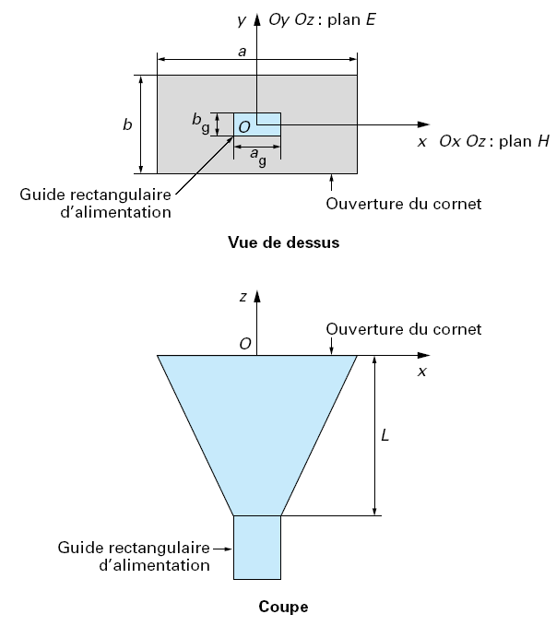
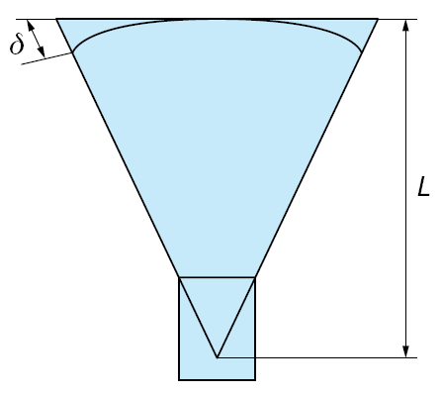
APERTURE ANTENNAS
Progressive aperture of a waveguide to free space conditions : the Horn antenna.
Example of rectangular horn

Slide 28
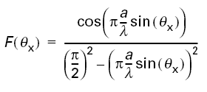
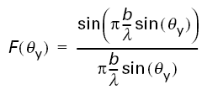
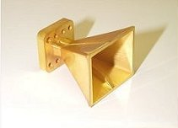
HORN CHARACTERISTICS
Radiation :
H plane:
E plane:

Slide 29
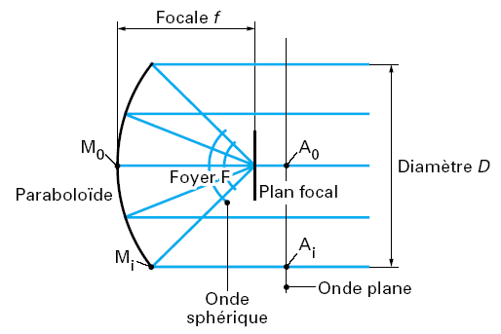
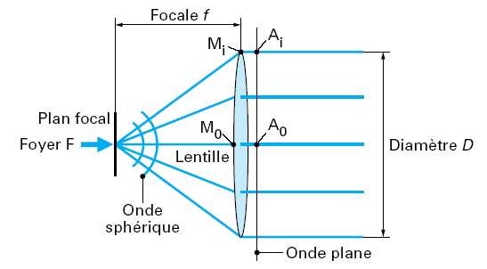
ANTENNAS WITH FOCUSING SYSTEM
The focusing systems use the principles of optics:
a plane wave is converted into a spherical wave or vice versa.
Lens : focusing system in transmission
Parabolic : focusing system in reflection

Slide 30
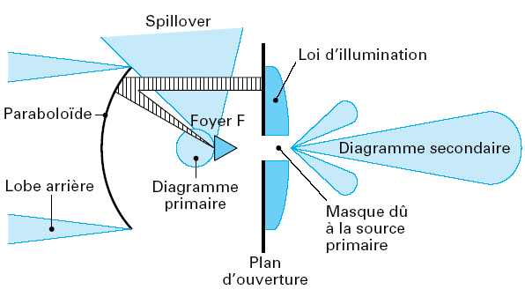

PARABOLIC DISH
A reflector is used to focus the energy to an antenna element placed at the focal point.
Approximation :
with k between 0.5 and 0.8

Slide 31
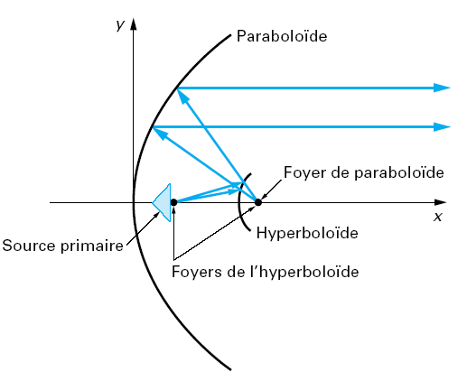
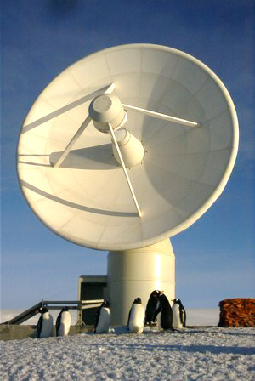
DOUBLE REFLECTOR SYSTEM
To improve the focusing, it is also possible to use two levels of reflectors: the principle of the Cassegrain antenna.

Slide 32
ANTENNA ARRAYS
When calculating the radiation of a resonant antenna, we sum the contributions of the elementary dipoles that provide radiation of the assembly. We are then constrained by the pre-determined laws of distribution of these currents (amplitude and phase).
The array principle is to use single antennas whose contributions are summed by controlling the amplitudes and phases with which they are fed.

Slide 33
COMBINATION PRINCIPLE
If we consider the combination of isotropic elementary sources supplied with the same amplitude and the same phase, the sum of the fields becomes:
approximation on the amplitude
θ
wavefront
d

Slide 34
ARRAY FACTOR
The principle of combination of the fields is the same regardless of the source radiation pattern. We then multiply by the characteristic function of the source.
R(θ)
Array factor or grouping factor
Pattern Multiplication

Slide 35
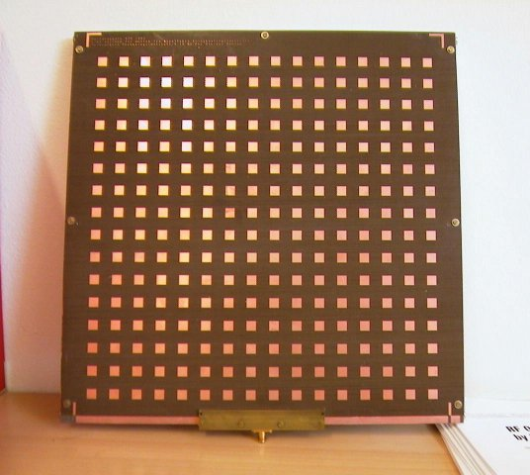
GAIN INCREASE
We can use the combination to increase the gain of an antenna.
From a basic directional antenna, the doubling of the number of elements increases the directivity by two.
Ex array of patch antennas:
patch alone : 6 dBi
What is the gain of an array of 256 ?

Slide 36
WEIGHTING
It may further choose the principle of combination of the laws of the radiating elements in phase and amplitude to change the array factor.
Electronic steering
θ
wavefront
d

Slide 37
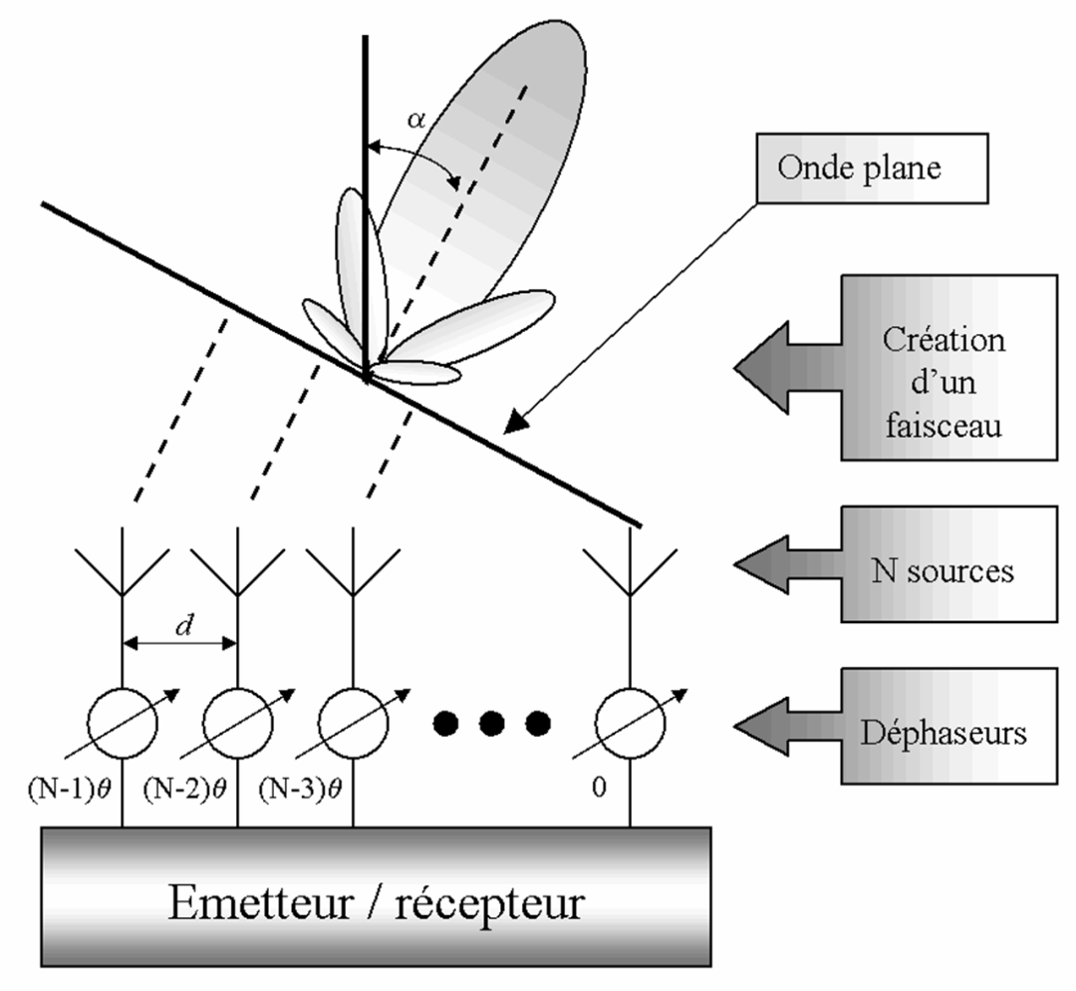
BEAMFORMING
To create the necessary laws of amplitudes and phases, we may use an array of fixed or reconfigurable distribution.
Multibeam antennas
Adaptive or smart antennas

